Slide 1
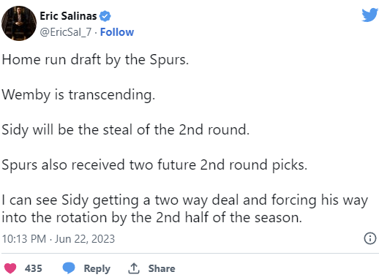
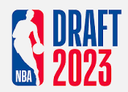
How did NBA Twitter feel about #Wemby?
# of Tweets
3,063
# of Likes
84,811

